Slide 1
Administering an Intramuscular Injection
Lesson Two
Beth Ghioldi, Lori Fusco, Brittany Mancini

Slide 2
Review Questions
The label on the medication package or container should be checked three times during medication preparation and administration.
a. True
b. False

Slide 3
Review Questions
Before administering a medication to a patient, the nurse must clearly understand why the patient is receiving the medication.
a. True
b. False

Slide 4
Review Questions
When removing medications from a vial, the nurse must wear sterile gloves.
a. True
b. False

Slide 5
Review Questions….
It is important to remember to prepare medications for only one patient at a time.
a. True
b. False
Older adults are more sensitive to medication due to the aging process.
a. True
b. False

Slide 6
Answers
                True
                True
                False
                True
                True
Great Job!

Slide 7
Intramuscular Injections
Intramuscular injections deliver
medication into a muscle
Large muscles contain large
blood vessels that allow for a
rapid uptake of the medication
by the body
The larger muscle disperses the
medication over a few hours

Slide 8

Intramuscular Injections
To administer an intramuscular injection correctly you must:
Select the appropriate equipment
Select the appropriate location
Use the correct technique

Slide 9
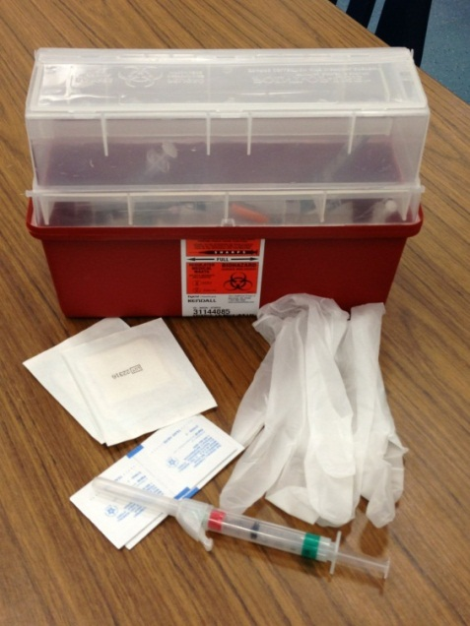
Selecting the Appropriate Equipment
Equipment required for administering an intramuscular injection:
  Disposable gloves
  Sterile syringe and needle of correct size and gauge
  Antimicrobial swab
  2x2 gauze

Slide 10
Equipment
Needle Length
  Based on the site for injection and patient size
    Obese patient may require a longer needle
    Extremely thin patients may require a shorter needle
Use a 1 – 2 inch needle

Slide 11
Equipment
Needle Gauge
Appropriate gauge is determined by viscosity of medication being administered
    Thick, oil based medications may require a larger gauge
    Thinner solutions may be administered with a smaller gauge
Use an 18 – 23 gauge needle

Slide 12
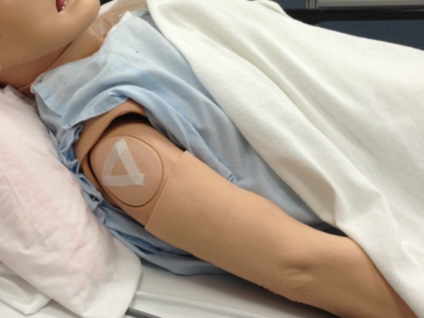
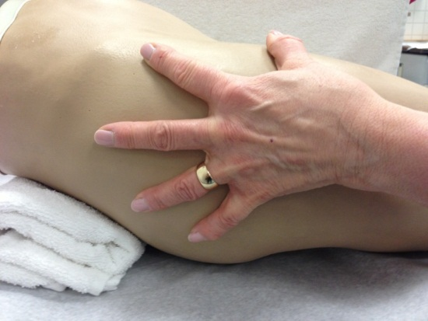
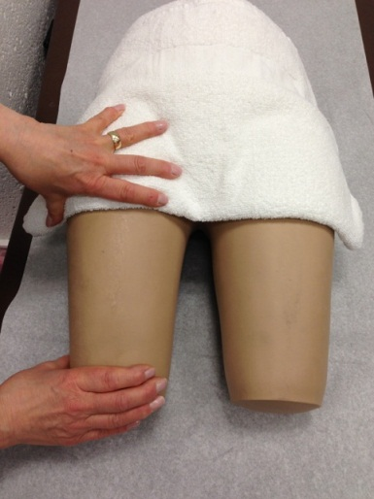
Selecting the Appropriate Location
Intramuscular Injection Sites:
  Deltoid
  Ventrogluteal
  Vastus lateralis

Slide 13
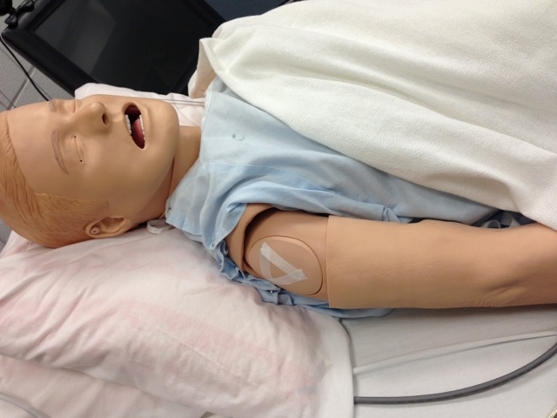
Location
Deltoid
  Use landmarks and site boundaries to locate exact site
  Find the lower edge of the acromion process on the upper arm

Slide 14
Location
  The Deltoid site is 2 fingerbreadths below the acromion process
  Make an imaginary inverted triangle at the site and inject the needle in the center of the triangle

Slide 15

Location
Ventrogluteal
  Use landmarks and boundaries to locate the exact site
  Locate the greater trochanter and the anterior superior iliac spine

Slide 16

Location
    Place the heel of your hand over the greater trochanter with your thumb pointing towards the patient’s groin
    Your index finger should point toward the anterior superior iliac spine
Ventrogluteal

Slide 17
Location
  Your middle finger should point towards the iliac crest
  The injection site is located between your index and middle fingers
Ventrogluteal

Slide 18

Location
Vastus Lateralis
  Use landmarks and boundaries to locate the exact site
  Locate the patella and the greater trochanter
  The vastus lateralis is located a handbreadth below the greater trochanter and a handbreadth above the patella.

Slide 19
Location
  Divide the thigh into thirds horizontally and vertically
  The injection is given in the outer middle third of the muscle
Vastus Lateralis

Slide 20
Correct Technique
Careful technique is important when administering intramuscular injections in order to avoid complications such as:
      Abscesses
      Injury to vessels, bones and nerves
      Lingering pain
      Tissue necrosis

Slide 21
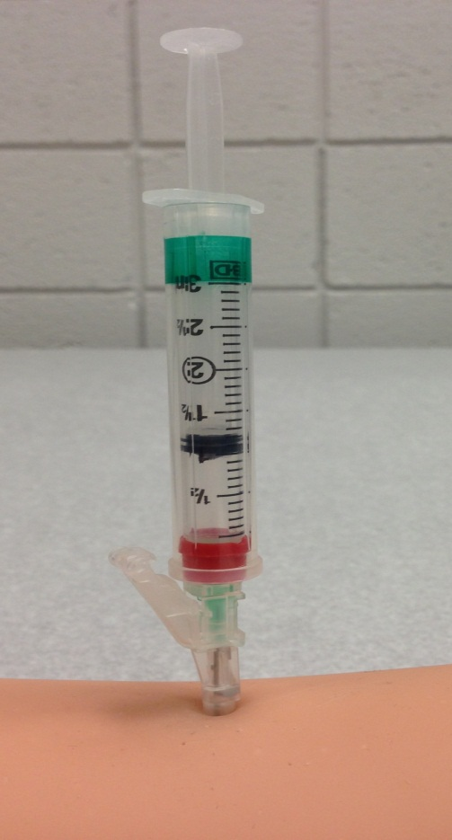
Technique
Administer the intramuscular injection so that the needle is at a 90 degree angle to the patient’s body.

Slide 22
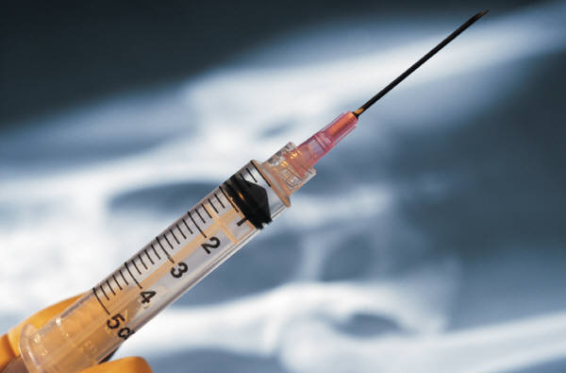
Technique
The volume of medication that can be administered intramuscularly varies based on the intended site.
1 - 4 ml for the ventrogluteal and vastus lateralis sites
0.5 – 1 ml for the Deltoid site
Microsoft Clip Art

Slide 23
Technique
Performing the Injection
Identify the patient by verifying name and date of birth.
Perform hand hygiene and apply clean gloves.
Select appropriate site for injection.

Slide 24
Technique….
Cleanse the injection site with an antimicrobial swab. Use a firm, circular motion while moving outward from the injection site. Allow to air dry.
Remove needle cap, hold syringe in dominate hand, and with non-dominate hand spread skin tightly.

Slide 25
Technique….
Inject needle quickly at a 90 degree angle into the muscle.
With non-dominate hand, stabilize the syringe barrel and move dominate hand to syringe plunger.
Inject the medication slowly. (10 seconds per milliliter of medication)

Slide 26
Technique…..
Withdraw the needle quickly and smoothly.
Apply gentle pressure at the site with a dry 2x2 gauze.
Activate the needle safety device and discard the needle and syringe in the appropriate sharps container. Do not recap the needle!

Slide 27
Technique….
Remove gloves and perform hand hygiene.
Make sure patient is safe and comfortable.
Document medication administration.
15. Record any unexpected outcomes.

Slide 28
Tips for Decreasing Pain During Injections
Explain the procedure to the patient.
Encourage the patient to relax.
Position patient.
Do not inject into hardened or very sensitive skin.

Slide 29
Tips …
Inject medication slowly. (10 seconds per milliliter of medication)
Maintain grasp on the needle. Do not move the needle after it is inserted.
Withdraw the needle quickly and smoothly.

Slide 30
Practice Makes Perfect
You have now completed Lesson Two!
To administer an intramuscular injection correctly you have learned to:
Select the appropriate equipment
Select the appropriate location
Use the correct technique

Slide 31
References
Lynn, P. (3rd). 2011. Taylor’s clinical nursing skills: A
  nursing process approach. New York, NY: Lippincott.

